Slide 1
Prediction of Epileptic Seizure in EEG
Ronald Broberg
CS 5870
UCCS Fall 2014

Slide 2
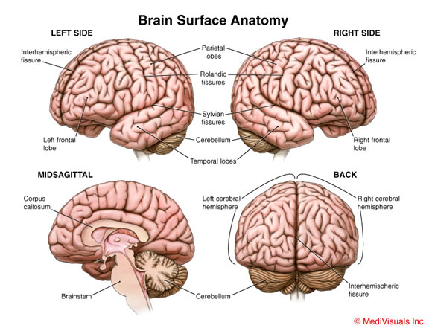
Brains
Complex Anatomy
2 Hemispheres
Each Hemisphere Layered
Substructures in each Layer
http://universalhealthcarela.com/photos-of-anatomy-of-human-brain/

Slide 3
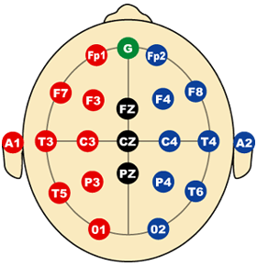
ElectroEncephalograms (EEG)
The International 10-20 System of Electrode Placement
The International 10-20 System of Electrode Placement
is the most widely used method to describe the placement
of electrodes at specific intervals along the head.
Each electrode site has a letter to identify the lobe,
along with a number or another letter to identify
the hemispheric location.
http://www.immrama.org/eeg/electrode.html

Slide 4
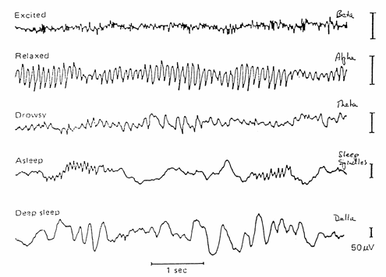
Typical EEG Patterns
Brain Waves Vary by State of Consciousness
Beta Waves
Alpha Waves
Theta Waves
Sleep ?????
Delta Waves
http://neurodevelopmentcenter.com/

Slide 5
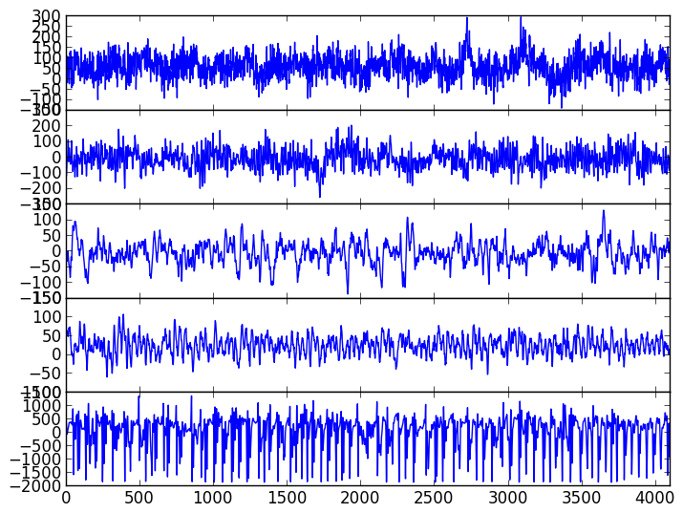
Atypical EEG Patterns
Bonn Data
A) Eyes Open - Extracranial
B) Eyes Closed – Extracranial
C) Intracranial – Asymptotic
B) Intracranial – Non-Seizure Hemisphere
E) Intracranial - Seizure

Slide 6
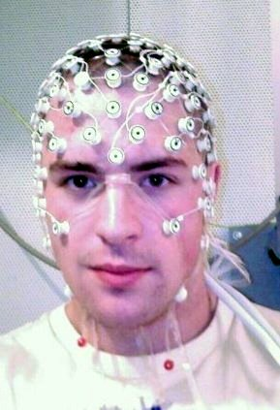
Extracranial Electrodes
Electrodes attached to skin outside of brain
http://en.wikipedia.org/wiki/Electroencephalography

Slide 7
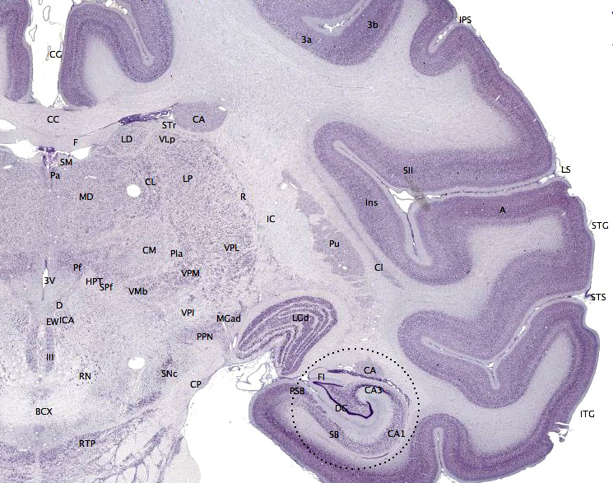
Brain in Cross Section
Seizures can occur deep in brain structure
Not well captured at surface
Noisy signal
http://en.wikipedia.org/wiki/Hippocampus

Slide 8
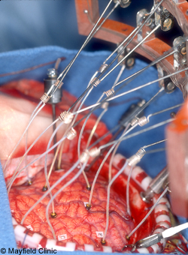
Intracranial Electrodes
Intracranial electrodes capture better signal
Highly invasive
Expensive
http://www.mayfieldclinic.com/PE-EpilepsySurg.htm

Slide 9
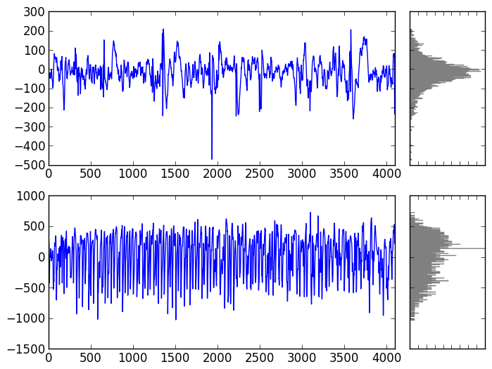
Epileptic Seizures in EEG

Slide 10
Classification of Epileptic Seizures
Features
Variance
Entropy
Fractal Complexity
FFT
Issues
Stochastic
Non-Stationary

Slide 11
Prediction of Epileptic Seizures
History

Slide 12
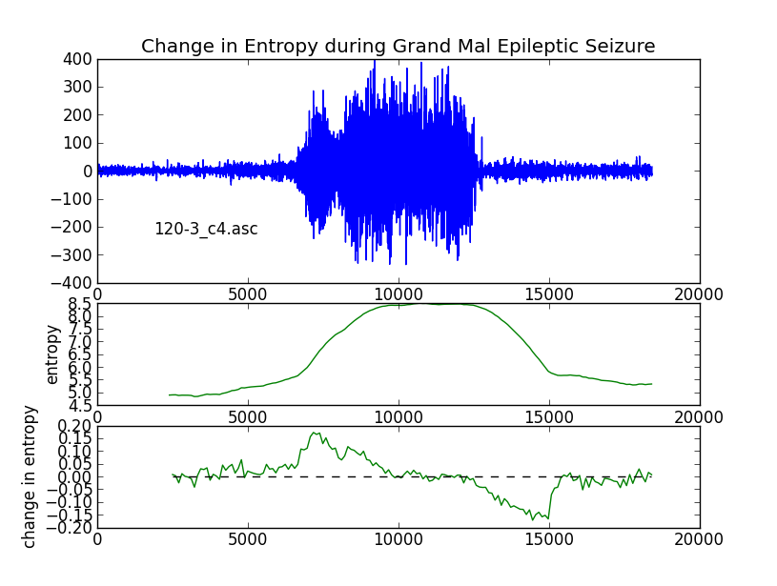
Time Evolution of Epileptic Seizures

Slide 13
Sensitivity: Demonstration
Original Image
Similar Images

Slide 14
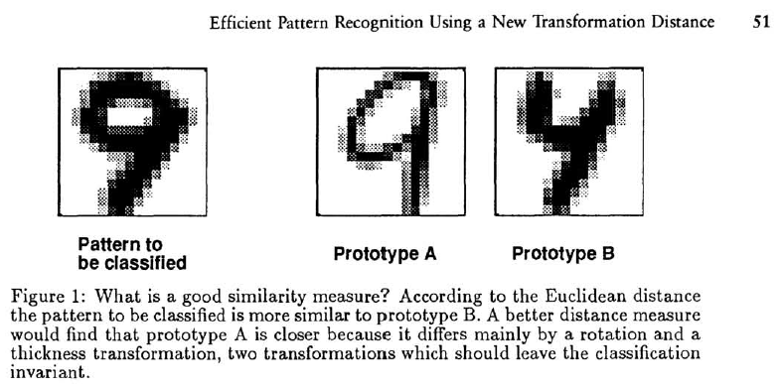
Simard (1993)

Slide 15
Sensitivity
Euclidean Distance
Image 1 / Image 2
Sensitive to …
… translation
… rotation
… line thickness
… lighting
… scale
… 6
… 7

Slide 16
Convolutional Neural Networks
In computer science, a convolutional neural network is a type of feed-forward artificial neural network where the individual neurons are tiled in such a way that they respond to overlapping regions in the visual field. Convolutional networks were inspired by biological processes and are variations of multilayer perceptrons which are designed to use minimal amounts of preprocessing. They are widely used models for image recognition.
http://en.wikipedia.org/wiki/Convolutional_neural_network

Slide 17
Feature Maps from Convolution
Conceptually, a feature map is obtained by convolving the input image with a linear filter, adding a bias term and then applying a non-linear function.
If we denote the k^{th} feature map at a given layer as h^{k}, whose filters are determined by the weights W^{k} and bias b_{k}, then the feature map h^{k} is obtained as follows (for tanh non-linearities):
http://deeplearning.net/tutorial/lenet.html

Slide 18
Max-Pooling
Another important concept of CNNs is that of max-pooling, which is a form of non-linear down-sampling. Max-pooling partitions the input image into a set of non-overlapping rectangles and, for each such sub-region, outputs the maximum value.
Max-pooling is useful in vision for two reasons: (1) it reduces the computational complexity for upper layers and (2) it provides a form of translation invariance.
To understand the invariance argument, imagine cascading a max-pooling layer with a convolutional layer. There are 8 directions in which one can translate the input image by a single pixel. If max-pooling is done over a 2x2 region, 3 out of these 8 possible configurations will produce exactly the same output at the convolutional layer. For max-pooling over a 3x3 window, this jumps to 5/8.
Since it provides additional robustness to position, max-pooling is thus a “smart” way of reducing the dimensionality of intermediate representations.
http://deeplearning.net/tutorial/lenet.html

Slide 19
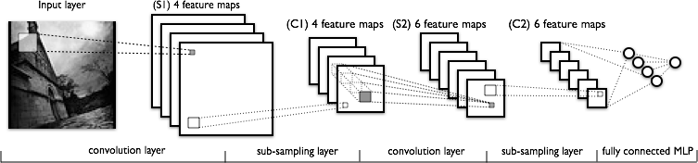
CNN Architecture
Multi-layered CNN
2 Convolution Layers
2 Sub-sampling Layers
http://deeplearning.net/tutorial/lenet.html

Slide 20
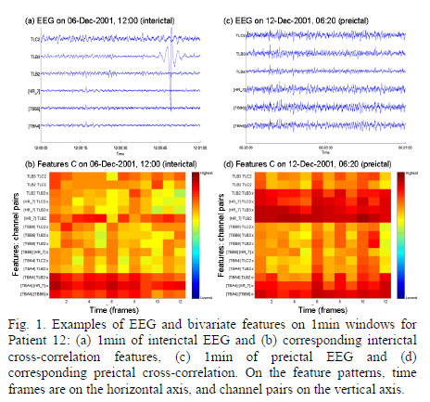
Mirokowski: CNN for Seizure Prediction

